Slide 1
Pre Calculus 12 Section 2.3 Solving Radical Functions
© Copyright all rights reserved to Homework depot: www.BCMath.ca

Slide 2
I) Steps for Solving Radical equations
In this section here, we will look at how to solve an equation with radicals
When solving an equation with a radical,
First step is to “Isolate” the radical
Then square both sides of the equation to eliminate the radical
Solve the equation algebraically by expanding or factoring
Check if the answer is extraneous, plug it back in to the original equation (This is an important step b/c not all answers are correct)
If both sides are equal, then the answer is correct
If both sides are not equal, then the answer you have is called an “extraneous root”
Graphing a radical function can help identify “extraneous roots”

Slide 3
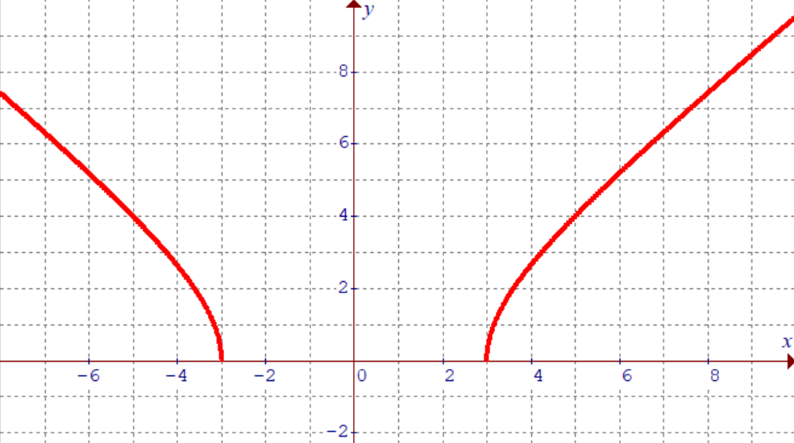
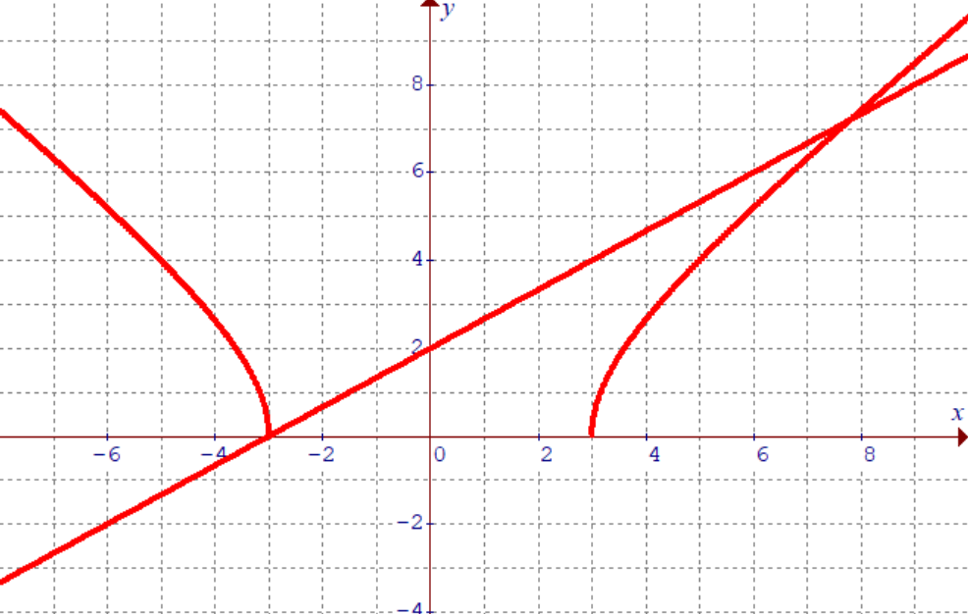
Ex: Solve the following Equations
After solving for “x”, plug both answers into your original equation to check if it is either an “ANSWER” or an “EXTRANEOUS ROOT”
YEP it works….
YEP it works….
SO we have TWO solutions!

Slide 4
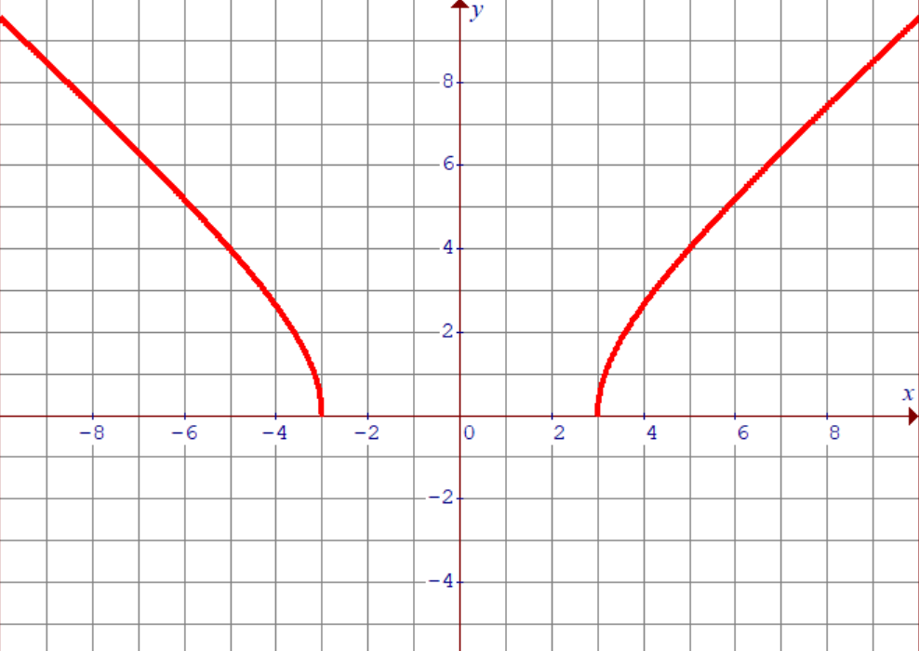

Slide 5
Practice: Solve the following equations and check for any extraneous roots:
Check for “EXTRANEOUS ROOTs”
X= 12/5 is a solution
X= -4 is a solution

Slide 6
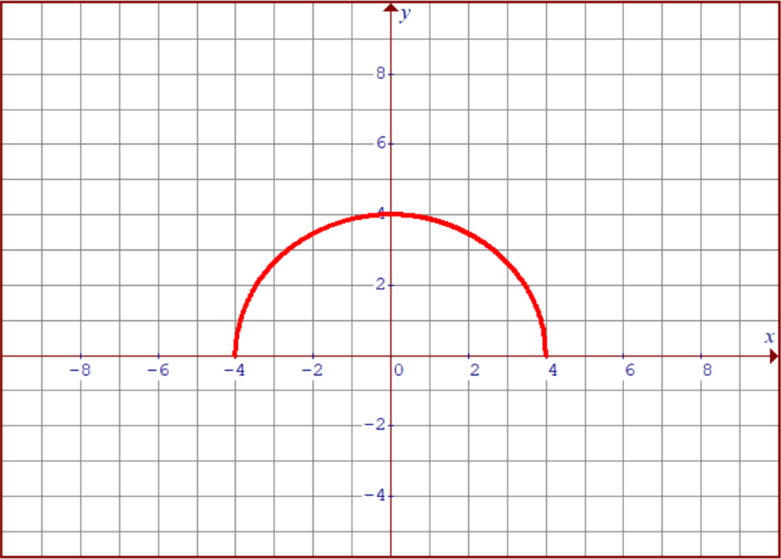
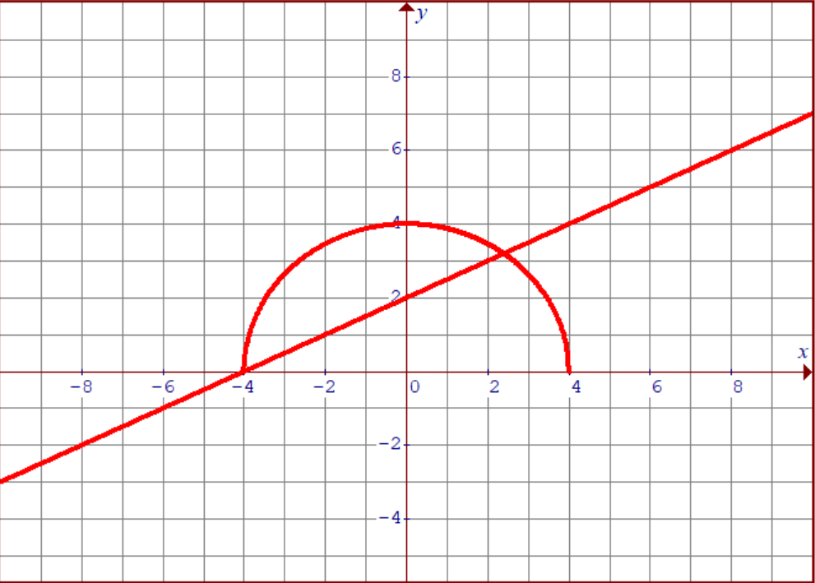

Slide 7
PLUG it in and check for extraneous roots:
X=0 is a solution
RIGHT side is negative, so both sides can not equal. Therefore, -72/80.5 is an extraneous root

Slide 8
What is an Extraneous Root?
An extraneous root is an answer that you get when you solve algebraically but does not make both sides of the equal when you plug it back in
Therefore, an extraneous root is not an answer
You get extraneous roots when solving radical functions b/c “squaring” both sides give you solutions “above” and “below” the x-axis
Since your radical function is above the X-axis, any intersections below the X-axis would be an extraneous point
y
8
6
4
There’s only ONE answer!!
2
x
-4
-2
0
2
4
6
8
10
Solve algebraically will give you both these two answers. However, the bottom point is an “extraneous root” because it’s not an answer (not an actual intersection point)
-2
-4
EXTRANEOUS! NOT AN ANSWER

Slide 9
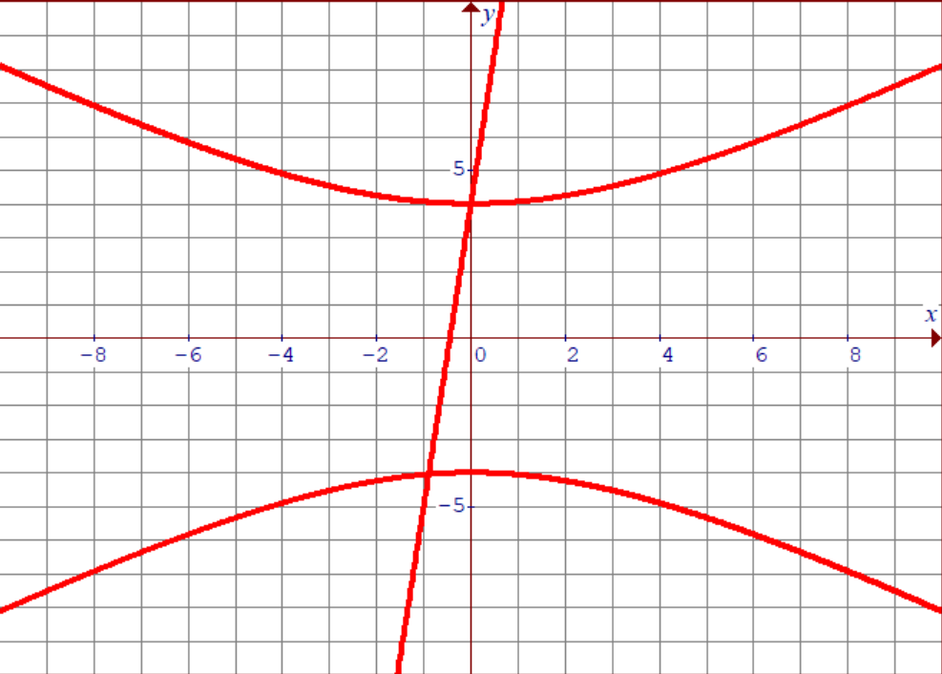
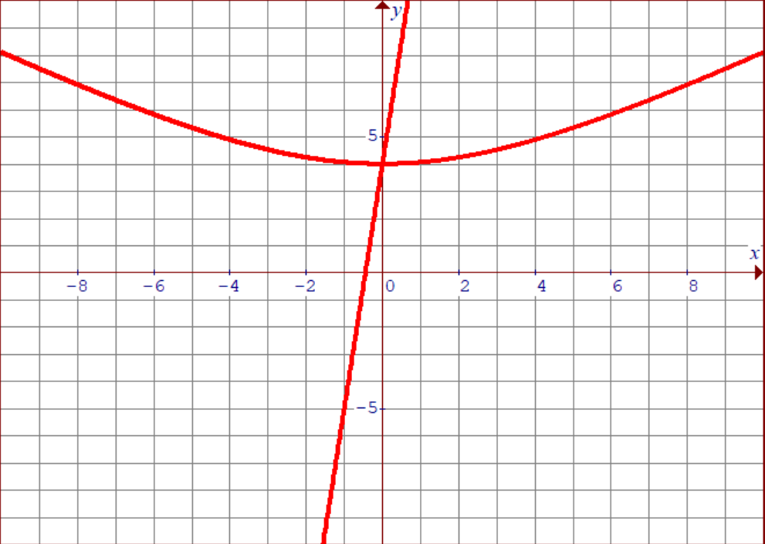
There’s only ONE answer!!
This one down here is an EXTRANEOUR ROOT!!!

Slide 10
How TO “DETECT” Extraneous Roots!
One of the main things you need to remember is that a radical above the axis can only be equal to a POSITIVE value
CASE 1: Radicals with a Negative Constant:
This is a positive radical, so it must be equal to a positive value
You have a negative constant on the right. A positive value can not be equal to a negative value
This means you will get an extraneous root and there are NO SOLUTIONS!!
CASE 2: Radicals with a linear function
The radical MUST be positive
Plug your answers here, if it is positive → answer is valid if it is negative → answer is extraneous!
Suppose you solve this equation and got two answers: $−1.6457 and 3.6457$

Slide 11
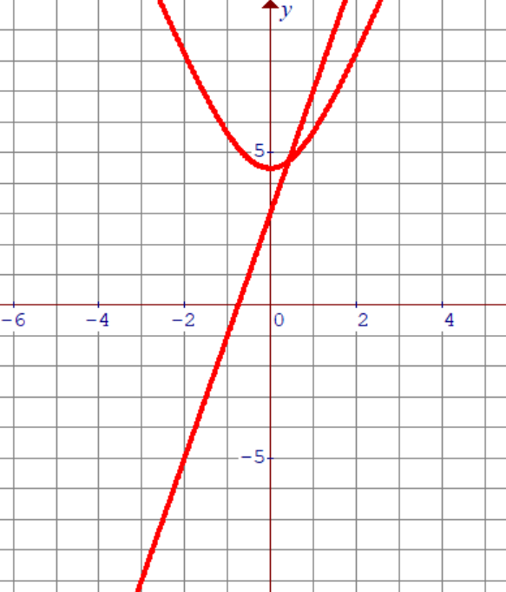
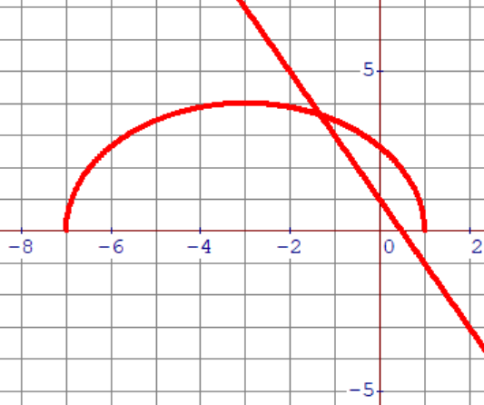
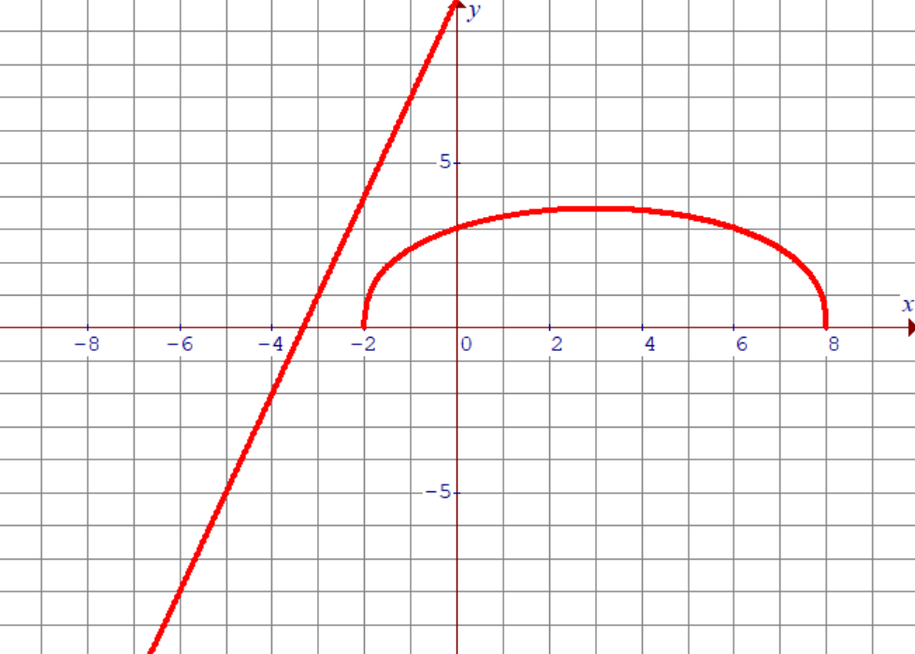
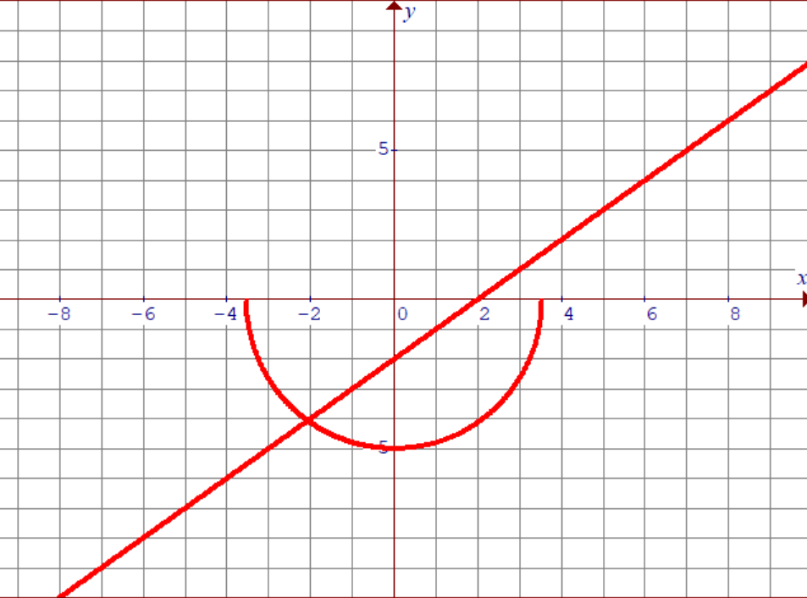
Practice: Indicate which equations have an extraneous root by graphing:

Slide 12
Ex: Solve
n = 2 is an
Extraneous root.
Therefore, n = 9 is the solution.

Slide 13
Cases with No Solution!
If there are no valid intersection points between the two sides of an equation, then there are no solutions!
Learn to sketch a general graph of the radical function
Ie: Opens UP/Down ? LEFT/RIGHT??? Where it begins?
OPENS UP
Straight line
OPENS UP
Straight line
OPENS Right start at -3
M=1 b=8
OPENS left start at 2
M=1 b=-4
y
y
8
8
6
6
4
4
2
2
x
x
-4
-2
0
2
4
6
8
10
-4
-2
0
2
4
6
8
10
By drawing a rough sketch, you can see that there are no intersections NO SOLUTIONS!!
-2
-2
-4
-4

Slide 14
iv) Cases with No Solution
Isolate the root
If the other side is a negative constant, then there will be no solution (No intersection)
If there are no intersections, then no solutions!
y
y
4
8
2
6
x
4
-4
-2
0
2
4
2
-2
x
-4
-2
0
2
4
6
8
10
-2
-4
-4

Slide 15
Ex: Which of the following equations will have an extraneous root?

Slide 16
Practice: Expand the following
YOU NEED TO FOIL!!!

Slide 17
V) Solving Equations with TWO Radicals??
1. Move one of the radicals to the other side
2. FOIL both sides
3. Make sure you know how to expand each side correctly!!
5. Square both sides again
4. Simplify and solve for “x”
6. Go and check your solution

Slide 18
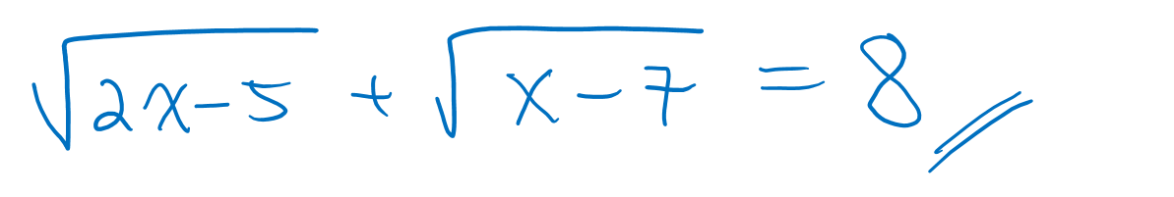

Slide 19
Check:
So x = 6 is extraneous
Therefore, x = 1 is the solution.

Slide 20
1. Square both sides
2. Don’t forget to FOIL!!
3. Square both sides AGAIN!!

Slide 21
4. Move all terms to one side, combine liketerms, factor and solve…..
One of these is extraneous….go find out….

